Slide 1
QlikSense Training
I&D India – QlikSense CoE

Slide 2
Session 04

Slide 3
Session Agenda
Chart Types
Bar Chart
Combo Chart
Gauge Chart
Line Chart
Map
Pie Chart
Scatter Chart
Tree map

Slide 4
Chart Types
Charts present relationships among many values efficiently, and provide you with a way to analyze data at a glance. The best choice of chart type depends on the purpose of the visualization. For instance, tables are useful when you need to view precise values, and when you want to compare individual values to each other.
Purpose of visualization | Recommended chart type
Compare data side by side | Bar chart
Combine absolute and relative values | Combo chart
Make selections to reduce data set | Filter pane
Indicate ratio | Gauge
Display a performance value | KPI
Display trends over time | Line chart
Display point and area data | Map
Display ratio to total | Pie chart
Create a cross table view of data and to summarize data | Pivot table
Display correlation of measures | Scatter plot
Display numbers and values | Table
Display text, images, links, and measures | Text & image
Display hierarchical data | Treemap

Slide 5
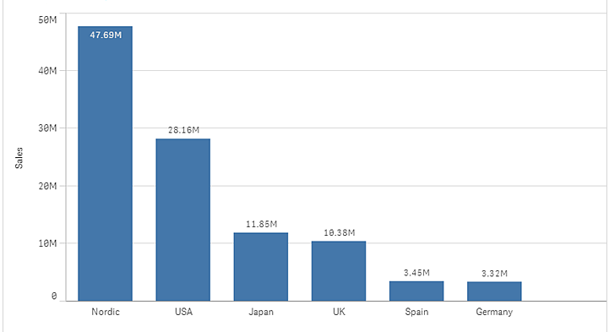
Bar Chart
Bar chart
The bar chart is suitable for comparing multiple values. The dimension axis shows the category items that are compared, and the measure axis shows the value for each category item.
Example:
The dimension values are different regions: Nordic, USA, Japan, UK, Spain, and Germany. Each region represents a dimension value, and has a corresponding bar. The bar height corresponds to the measure value (sales) for the different regions.
Number of dimensions and measures
When using | Max limit
1 dimension | 15 measures
2 dimensions | 1 measure
1 measure | 2 dimensions
2 -15 measures | 1 dimension

Slide 6
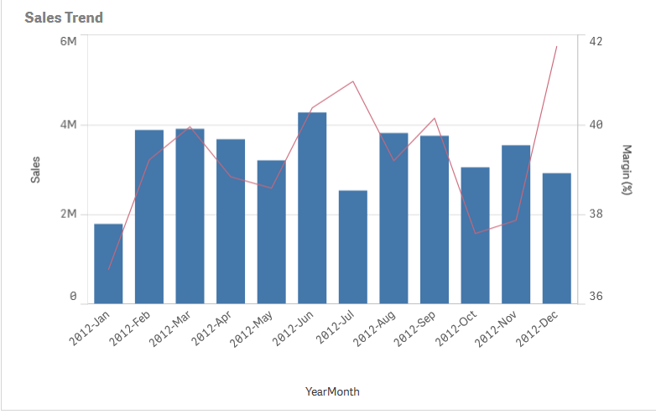
Combo chart
combo chart:
The combo chart is suitable for comparing two sets of measure values that are usually hard to compare because of the differences in scale
A typical example is when you have a bar chart with sales figures and want to combine these figures with the margin values (in percent). In a regular bar chart, the bars for sales would be displayed as usual, but the margin values would be almost invisible because of the very large difference between the numeric values for sales and margin.
Number of dimensions and measures:
In a combo chart, you need at least one dimension and one measure. You can only have one dimension but up to 15 measures.

Slide 7
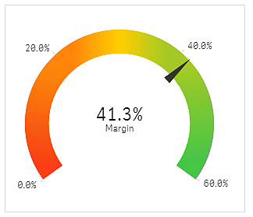
Gauge chart
Gauge
The gauge is designed to show a single measure value and visualize how to interpret that value.
Number of dimensions and measures
In a gauge you can only have one measure and no dimensions.
When to use it
The gauge is often used to present KPIs, for example, on an executive dashboard, and together with segmenting and color coding, it is an effective way of illustrating a performance result.
It is important to set relevant max and min values to support the interpretation of the value. You can use a reference line to provide additional context.
Advantages
A gauge is easy to read and understand and gives an instant indication of the performance within an area.
Disadvantages
The gauge is quite space-demanding in relation to the single value it visualizes.
Although visually compelling, the gauge is not always the best choice for presenting a single measure value. Problems when deciding the max and min values can indicate that some other visualization should be used.
If you only want to show a performance value, without a gauge, consider using a KPI instead.

Slide 8
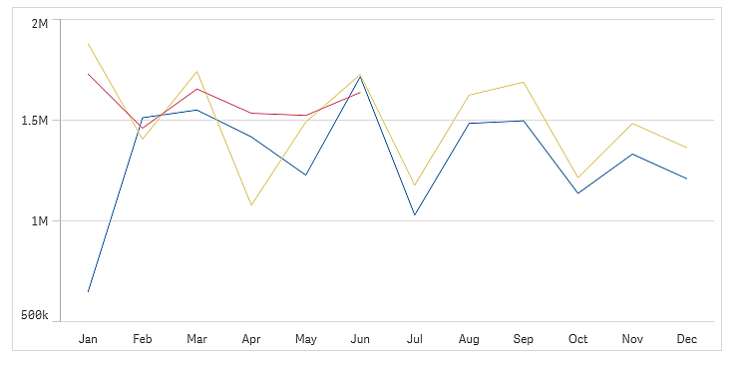
Line Chart
Line Chart
The line chart is used to show trends over time. The dimension is always on the x-axis, and the measures are always on the y-axis. The orientation cannot be changed to vertical.
When using | Max limit
1 dimension | 15 measures
2 dimensions | 1 measure
1 measure | 2 dimensions
2 -15 measures | 1 dimension

Slide 9

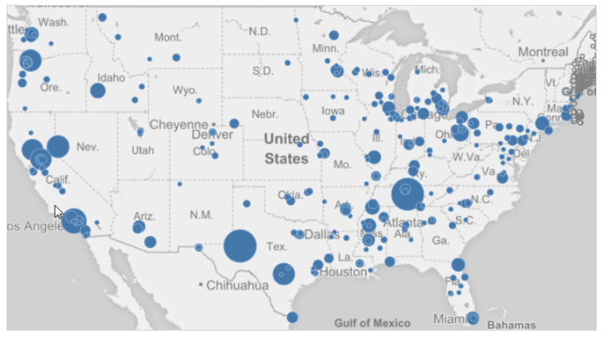
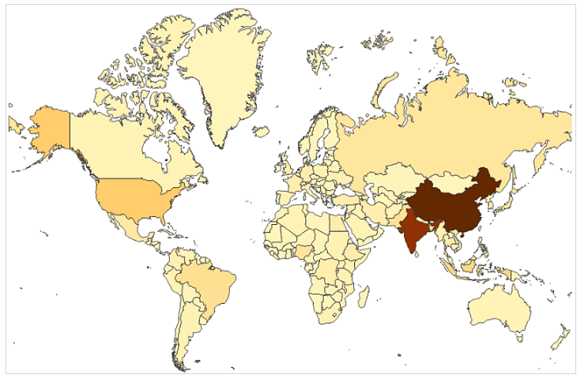
Maps
Map
Maps can be used for a wide variety of purposes. A common use in business intelligence is to plot sales data per region or per store.
You can create a map by using either a point layer (KML or Excel file) or an area layer (KML file).
A point layer map is typically used to mark places of interest, such as airports or office locations, using longitude and latitude coordinates.
An area map can be used to display geographical areas, such as countries.
Number of dimensions and measures
You can only use a single dimension type: point or area. You can create an expression in the dimension. If you add a measure from the master items to the map, the measure is added in the expression box under Data > Layers > <layer type> in the properties panel.
Point Layer Map
Area Map

Slide 10
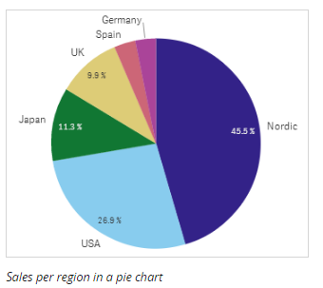
Pie Chart
Pie Chart:
The pie chart displays the relation between values as well as the relation of a single value to the total. You can use a pie chart when you have a single data series with only positive values.
Number of dimensions and measures
A pie chart is built from one dimension and one measure only.

Slide 11
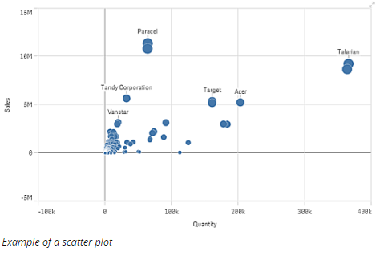
Scatter Chart
Scatter plot
The scatter plot presents pairs of values from two or three measures.
This is useful when you want to show data where each instance has two numbers, for example, the relationship between Sales and Quantity per Customer. In the scatter plot below, a third measure (Cost) is used to generate the bubble size.
Number of dimensions and measures
In a scatter plot you need one dimension and at least two measures. You can have maximum one dimension and three measures, where the third measure is visualized as bubble size.

Slide 12
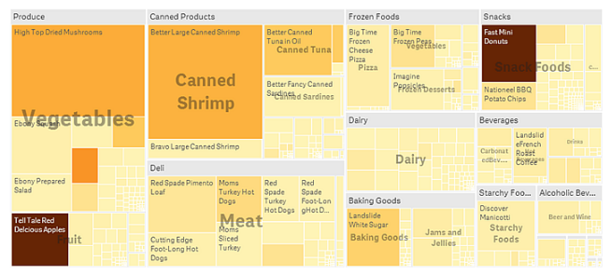
Tree map
Tree Map
Tree maps display hierarchical data by using nested rectangles, that is, smaller rectangles within a larger rectangle.
Number of dimensions and measures
In a treemap you need at least one dimension and one measure, but to make full use of the treemap it is preferable to have two or three dimensions. You can only have one measure, but up to 15 dimensions. However, using more than two or three dimensions is not recommended because the treemap may become unmanageable

Slide 13
QlikView Training – Session 03
Thank You

